Slide 1

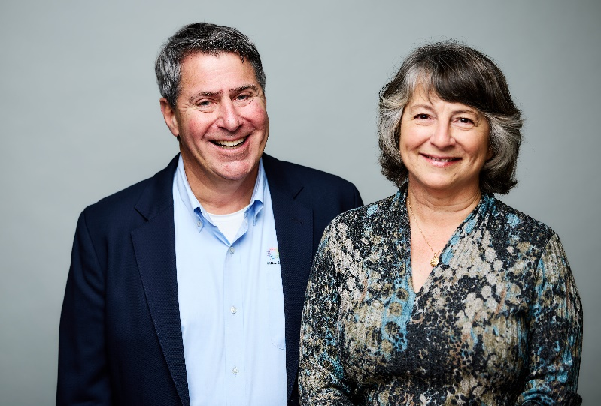
2nd Quarter 2024, Optics/Photonics/Laser
Talent Acquisition Landscape.
Rudzinsky Associates is a value adding partner to its clients.
Howard Rudzinsky
617/750-2663
Howard@OpticsJobs.com
linkedin.com/in/howardrudzinsky
60+ Years of Optics, Laser, Photonics, Industry / Talent Experience
Jenifer Bunis
206/499-2728
Jenifer@OpticsJobs.com
linkedin.com/in/jeniferbunis

Slide 2
Rudzinsky Associates, Uniquely Qualified/Accomplished:
Rudzinsky Associates has successfully completed hundreds of talent acquisition projects in Lasers, Optics, Photonics, Fiber-Optics, Imaging and related disciplines since its founding.
RA is a “SME” Subject Matter Expert in Optics, Laser, Photonics, Imaging Talent Acquisition, Talent Evaluation, the employment market nationally.
Rudzinsky Associates, “RA” possesses an unrivaled knowledge base in Optics, Lasers, Photonics/Device, Sytems Engineering, Sales/Marketing, R&D, Manufacturing/Operations Management.
RA has filled hundreds of positions at all levels from technicians, junior engineers, to the Director, VP, CEO/President level in Optical, Laser and Photonics related firms.
RA’s clients past and present read like a Who’s Who of Optical, Laser and Photonics Industry Leaders and Emerging Co’s.

Slide 3
RA has an unparalleled Network of Industry, Academic Contacts
RA maintains an extensive network of Industry contacts gained through 60+ years of continuous service to the Photonics Community Nationwide and Internationally.
RA has numerous contacts at all levels of organizations, from the factory floor to the “C”, “Executive” suite that we can immediately contact to engage on all level of assignments. These Laser, Optical, Photonics Technical Contributors /Thought / Industry Leaders take our calls!
RA does not have to learn Who is Who in the industry.
As Alumni of the University of Rochester, RA maintains a great relationship with the Institute of Optics. Jenifer Bunis is an advisory board member of Luminate, the Rochester Photonics Technology Incubator.
RA utilizes a dedicated research team, with direct industry experience to build a talent pipeline faster and more efficiently.

Slide 4
RA’s view of the Photonics /US Labor Market in the US in Oct. 2023
There were 8.5 million job openings in the US as of end of March 2024. There is less than ½ an unemployed person for every available job opening.
In March of 2024, 3.3 million workers quit their jobs, and total separations was 5.2 million workers both slightly down from the summer.
The national nonfarm unemployment rate remained at 3.9% in April 2024 and has remained between 3.6%-3.9% since April 2022. Those with bachelor degrees and higher have a 1.9% unemployment rate.
As of this date, May 2024, there are ~138,000+ job openings on Indeed that have the word laser, optics, fiber optics, photonics, imaging, physics or instrumentation in them.
According to the Bureau of Labor Statistics, engineering related professions are expected to continue growing at 3% per year through 2029.
Competition for “A” level talent is fierce now. Companies are facing both retention and talent attraction issues as a strategic gate to business growth.
Rudzinsky Associates acts as an extension of your organization, as brand, product, technology ambassadors, with the credibility to bring, attract and capture talent to your organization in an unparalleled, unrivaled manner.
(data provided from US Dept of Labor and or Bureau of Labor Statistics.)

Slide 5
RA’s approach to challenging talent acquistion projects
Jenifer and Howard start with introductory and then detailed discussions with your team as needed. Not only do we want to understand the specific opening in depth, but we also want to understand your culture, your organization dynamics, strengths, opportunities, success factors, your markets and customers.
With 45+ years of photonics talent evaluation, and talent acquisition experience, we bring a very focused approach to developing a pipeline of candidates for your role. Our industry experience helps this process to be as timely and cost effective as it can be.
Our process is dynamic, iterative, and employs a constant feedback loop.
We start with our personal industry network of colleagues, friends, past candidates, clients, and other industry and academic contacts in a network that is unrivaled by other talent firms.
Most importantly, we would never accept an assignment we are not highly confident we can complete.

Slide 6
How can you engage with RA?
Talk to Howard and Jenifer today! Howard c-617/750-2663.
Jenifer c-206/499-2728. Text message or call us.
Email us: Howard@OpticsJobs.com, Jenifer@OpticsJobs.com
This employment market for talent is highly competitive. Employers are desperate, using counteroffers to retain employees. Candidates are skittish, hedging their bets by engaging multiple opportunities concurrently. Last minute competing offers or “candidate surprises” including reneges are common. You need RA to be engaged with prospective candidates / potential employees through the entire talent acquisition cycle. We are good at this and mitigate against some of these downside risks.
Many of our assignments are “engaged searches”. You are buying RA’s subject matter expertise on a dedicated basis to see your talent project through to completion. More than 75% of our fee is on the table for us to earn upon successful completion. Engaged searches have priority in our firm over contingency assignments. We are closers. We fight for our clients.
We can also engage with clients on an exclusive contingency or contingency basis as well. We are happy to talk to you about your options, and your talent project’s details, nuances, complexity, challenges.

Slide 7
How does RA typically approach assignments?
0-45 days: RA talks to you/your team via phone/video conference for initial discussions. Search guidelines, position descriptions approach agreed to. RA reaches out to industry leaders and contacts, begins sourcing existing contacts we already know. On day 1 RA has people to call in mind already to start this search. RA starts establishing rapport with new contacts and starts identifying and reaching out to them and prospective candidates referred. As a dynamic, iterative process, clients receive weekly briefings on activity, contacts, pre-screening some candidates with client for calibration. This continuous feedback loop results in a very targeted search process.
30-90 days: RA builds rapport and starts to establish harder targets, while concurrently continuously identifying other targets for initial contact. As initial candidates express interest, further screening conversations including video interviewing occurs. Formal and informal (ie. back channel) reference screening occurs continuously. Promising candidates are preliminarily presented by a detailed presentation/write up and resume. If any candidates are viewed positively, initial phone screens scheduled with client’s team.

Slide 8
How would RA approach this challenging assignment cont.
60-90 days: Candidates that have been considered of interest continue to have initial phone screens with Human Resources, hiring managers and or Search Committee principals. Candidates considered of interest and viable are scheduled for initial meetings / interviews. If client wants RA to meet candidates first, arrangements made for an initial in person meeting. At this stage there should be several or more viable candidates that are of continuing interest and are in varying stages of discussion, presentation, conversation, scheduling. If client seeks to use any kind of “testing” we would have it done in conjunction with these initial interviews.
75-120 days: With 3-5 candidates in our pipeline, we narrow this down to 2-3 finalists and have another round of interviews. A finalist is selected and offer negotiations begin. At this stage all the facts of family, relocation, house, start date availability have been long on the table. Candidate at this stage of the process is “pre-closed” and parties negotiate a mutually satisfactory offer package.
90-150 days: Offer acceptance, start date agreed to. RA’s invoice arrives on the start date, we celebrate!
This timeline is an example of a sr level search. Searches can take more or less time depending on complexity/scarcity, but clients should be prepared for a 3-5 month total process timeline for senior level assignments 1.5-3 months for less senior roles.

Slide 9

How would RA approach challenging assignments cont.
This timeline is an approximate estimation of what we think is reasonable.
There are many factors that affect a search timeline; holidays, kids in school, a home to sell, a spouse/significant other’s profession. Our expectation is that a 3-6-month timeline for senior level searches has been typical in this highly competitive and labor challenged talent market. Less senior assignments have range from 1-3+ months. It could be longer, or we could find the right person sooner.
Rudzinsky Associates will work tirelessly to satisfy you our client and earn most of our fee upon successful completion. RA will make it our mission to bring our clients the exceptional candidate that will satisfy and or exceed your expectations, adding long-term value to your organization. RA looks forward to a long-term relationship with our clients and playing a key role in the present and future success and direction of your organization. Thank You for the Opportunity!
Howard Rudzinsky
www.OpticsJobs.com

Slide 10
SAMPLE OF RECENTLY COMPLETED ASSIGNMENTS
Position Location Notes
Dir Sales/BD NA Metrology West Coast 200k base OTE 250k+
Engineering Mgr / Optical Metrology Northeast 150k base plus equity
Director Business Strategy Northeast 215k base, 250k OTE
Laser Sales Mgr Biomedical Northeast 150k base, 200k OTE
President / CEO, Photonics New England 250k+ equity package, engaged search
VP Engineering, Thin Films, PV Northeast 225k+ equity package, engaged search
Laser Business Development Mgr West Coast to 200k+ package, engaged search
US based Laser Division General Mgr West Coast 250k+ package, engaged search
VP Engineering, Silicon Photonics Northeast 200k+ early stage equity, engaged search
Electronic Imaging Sales Engineer Southeast 140k+ package, engaged search
Laser Sales Engineer, entry level Rocky Mtns 110k+ package, engaged search
Optical Components DOD Biz Dev Mgr Mid Atlantic 200k+ package, engaged search
NA Sales Director Photonics Components Mid Atlantic 190k+ package, engaged search
Euro/MidEast Sales Mgr, Optical Components Greece/Eur 170k+US package, engaged search
Sales Director N America, Optical Components Northeast 210k+ package, engaged search
Optical Testbed Director, Space Telescope Northeast 220k+pkg, engaged search
Inside Sales Engineer, Optical Instruments Midwest 90k+, engaged search
Sr Sales Mgr, Scientific Lasers West Coast 200k+ pkg
Principal Photonics Test Scientist / R&D West Coast 200k+ 50k sign on bonus, engaged search
Principal Optomechanical Engineer New England 150k + equity, engaged search

